Slide 1
VIRTUAL REALITY LEARNING AND HEALTHCARE ASSISTANT

Slide 2
WHAT IS VIRTUAL REALITY ?
Virtual Reality (VR) is the use of computer technology to create a simulated environment. Unlike traditional user interfaces, VR places the user inside an experience. Instead of viewing a screen in front of them, users are immersed and able to interact with 3D worlds.
By simulating as many senses as possible, such as vision, hearing, touch, even smell, the computer is transformed into a gatekeeper to this artificial world. The only limits to near-real VR experiences are the availability of content and cheap computing power. Virtual Reality’s most immediately-recognizable component is the head-mounted display (HMD).

Slide 3
Human beings are visual creatures, and display technology is often the single biggest difference between immersive Virtual Reality systems and traditional user interfaces.
For instance, CAVE automatic virtual environments actively display virtual content onto room-sized screens.
While they are fun for people in universities and big labs, consumer and industrial wearables are the wild west.

Slide 4
VIRTUAL CLASSROOM
ClassVR is a versatile platform using the power of Virtual and Augmented Reality for education and training from the classroom to the boardroom.
Early education is all about learning through experience. Find out how your youngest students can benefit from immersive 360 environments, used to enhance and complement the real-world exploration and play that builds a solid foundation in the pre-school years.
Ensuring students are engaged, motivated and challenged throughout their school career is a key priority for teachers. See how virtual and augmented reality can unlock potential, giving students new ways to experience learning and even create their own media.

Slide 5
VIRTUAL CLASSROOM CONT..
By combining innovative hardware, cutting-edge software, and awe-inspiring content, VR Classroom 2 equips teachers with all the tools needed for truly immersive learning. Additionally, online or onsite training and responsive support enable educators to deliver VR lessons with confidence.
Teachers can successfully engage students with VR very easy. Teachers can remotely manage and control all classroom devices from a single source.
And also can conduct quizzes and exams via VR.

Slide 6
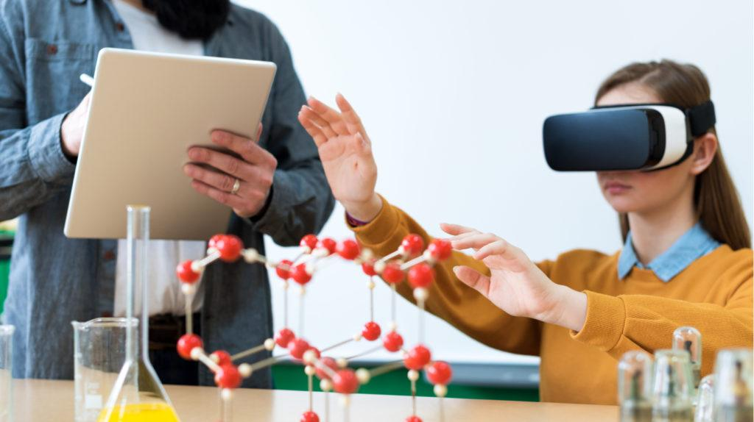
VIRTUAL REALITY IN SCHOOLS

Slide 7
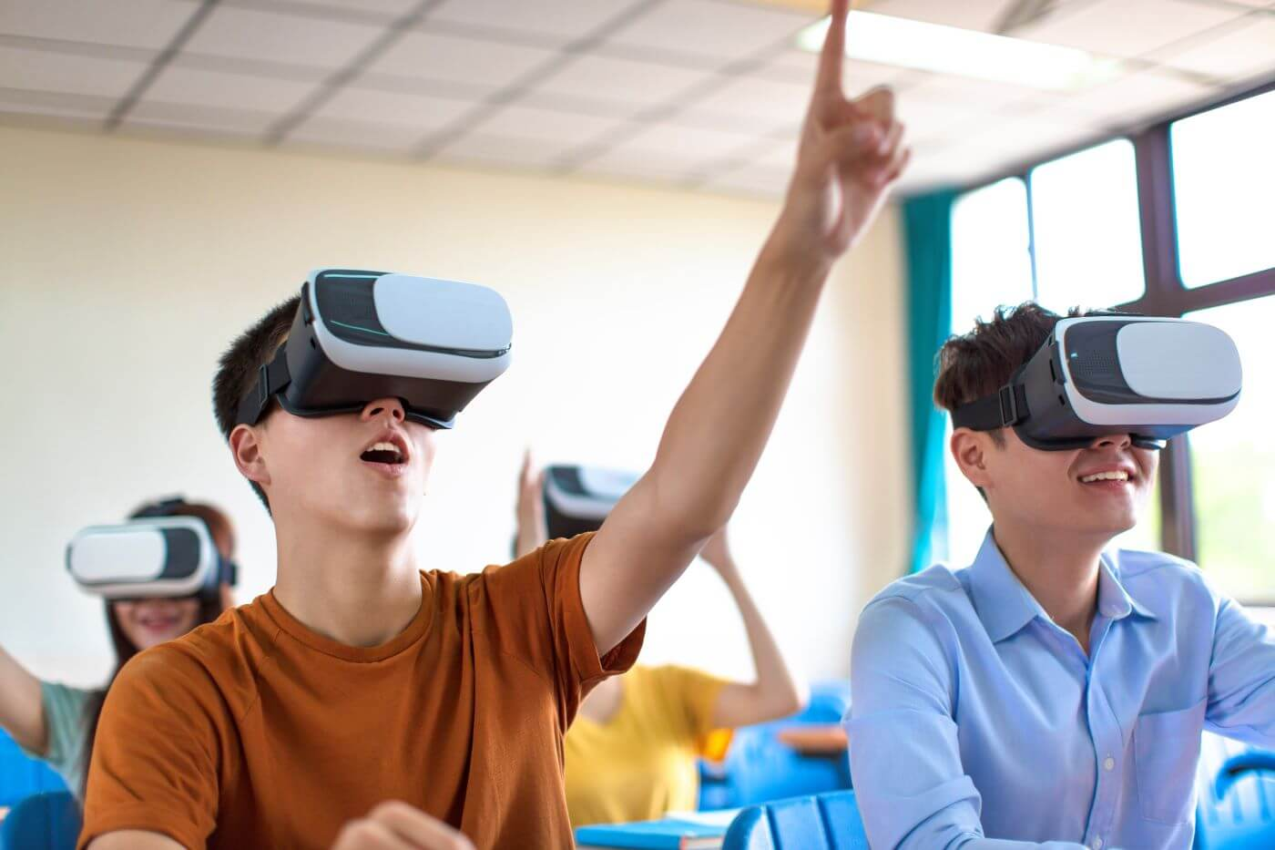
VIRTUAL REALITY IN SCHOOLS

Slide 8
Students always need not be in class to listen to the lessons they can be anywhere to listen to it. This helps them not miss class when they are sick or at home.
This will even bring students and teachers inside a VR environment in which they can talk, touch and feel virtually.

Slide 9
ROBOTIC SURGERY
Robotic surgery, or robot-assisted surgery, allows doctors to perform many types of complex procedures with more precision, flexibility and control than is possible with conventional techniques.
Robotic surgery is usually associated with minimally invasive surgery procedures performed through tiny incisions. It is also sometimes used in certain traditional open surgical procedures.
The above mentioned method is a traditional way of surgery in that the surgeon and the doctor are inside the same room ,there is no problem in data connectivity.

Slide 10
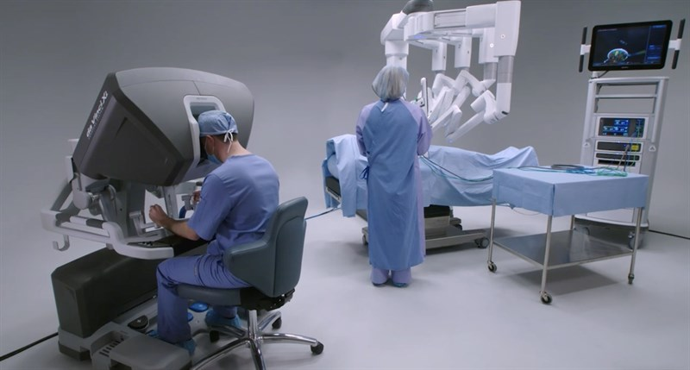
In VR Robotic Surgery surgeon gets the high-definition, magnified, 3-D view of a patient's body inside VR display.
Surgeons also get a 360 degree view of the surgical site which makes it more comfortable for them like they are inside an actual surgical site.
And surgeons located away from the patient get a glouse (controller for the arm) which controls the robotic arm remotely.

Slide 11
VIRTUAL REALITY IN MEDICINE
Virtual Reality in used in medical industry in various fields such as
Medical training
Patient treatment
Medical marketing
Disease awareness

Slide 12
ADVANTAGES
Surgeons who use the robotic system find that for many procedures it enhances precision, flexibility and control during the operation and allows them to better see the site, compared with traditional techniques.
Using robotic surgery, surgeons can perform delicate and complex procedures that may have been difficult or impossible with other methods. And also surgeons can operate anywhere where there is good data connectivity. It gives them more mobility.

Slide 13
These kind of solutions can be used during this kind of COVID-19 pandemic outbreaks and lockdowns.
It creates the same classroom kind of environment virtually anywhere.

Slide 14
CONCLUSION
This can not only be used during pandemic outbreaks and lockdowns but also can be used in normal classes.
As it provides better explanation on the subject and 3D animation provides exart visualization of the subject
Future education system depends on VR classrooms as it’s an immersive technology for assistive learning.

Slide 15
THANK YOU

